Slide 1
SRF Linacs Driving Subcritical MS Reactors vision: Burning LWR SNF On 65 US Sites path to vision: Burning Pu at SRNL
Rolland Johnson
Muons, Inc. - http://muonsinc.com/

Slide 2
BHAG: Big Hairy Audacious Goal,
from“Built to Last: Successful Habits of Visionary Companies”
by Jim Collins and Jerry Porras (2004)
Bob Wilson’s BHAG: make superconducting magnets so powerful and efficient that they make possible new kinds of accelerators and colliders to study the smallest things in the universe.
1970s – SC magnet conductor developed
major spin-off – SC magnets for MRI
1982 – SC Energy Doubler/Accelerator
1985 – Tevatron proton-antiproton collider
1995 – Discovery of the Top Quark
2010 – Large Hadron Collider
2014 – Discovery of Higgs Boson

Slide 3
To make SRF accelerators so powerful and efficient that they make enough neutrons to produce nuclear energy for electricity or process heat at less cost than from wind, solar, or natural gas, without weapons proliferation legacies of enrichment and chemical reprocessing, by burning unwanted nuclear materials.
Our Big Hairy Audacious Goal:

Slide 4
New Technology, Old Technology
Superconducting Radio Frequency Accelerators
  First demo of scale and power needed
    Oak Ridge National Lab Spallation Neutron Source
    Achieves 1 MW power Sept 28 2009 -1.4 MW now
    6% duty factor implies more than 20 MW CW possible
Molten-Salt Graphite-Moderated Reactor
  ORNL Molten Salt Reactor Experiment (MSRE)
    new approach to reactors(1964-1969)
Merging these technologies allows
  Eliminating enrichment and chemical reprocessing
  Subcritical operation for safety and easier licensing
  Deeper burns to extract more energy from fuel

Slide 5
What is Muons, Inc.?
Muons, Inc.
  Founded 2002, subsidiaries - MuPlus, Mu*STAR
    by Scientists from US National Labs
  Funded by DOE contracts and SBIR-STTR grants
    total of ~$30M
  Tools and technology for particle accelerators
  8 US university and 11 national lab research partners
    extraordinary people work with us
  Supported 18 post-docs and 7 Ph.D. students
  accelerator-driven molten-salt nuclear reactors
    Major focus of our companies

Slide 6
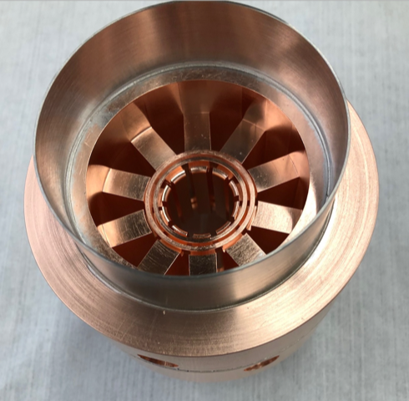
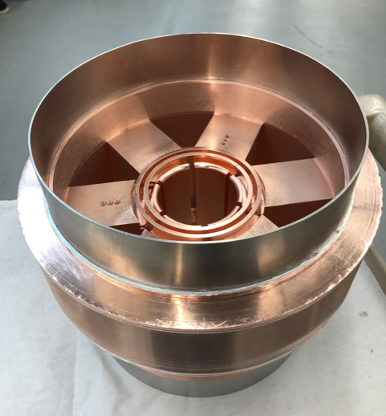
SRF Linacs need efficient microwave power
Muons, Inc. is developing power sources for Superconducting Radio Frequency Linacs
under SBIR-STTR awards and contracts. First tests of two magnetrons underway now.
Magnetrons up to 90% efficient vs klystrons 50%. Capital cost 1/5 of klystrons
Replaces CEBAF klystrons
Replaces tetrodes for Mo99 production
1497 MHz
4” D
350 MHz
140 kW CW
10” D

Slide 7
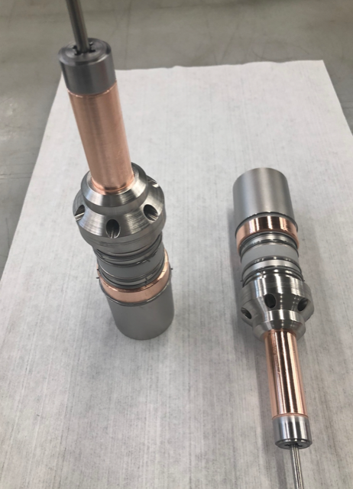
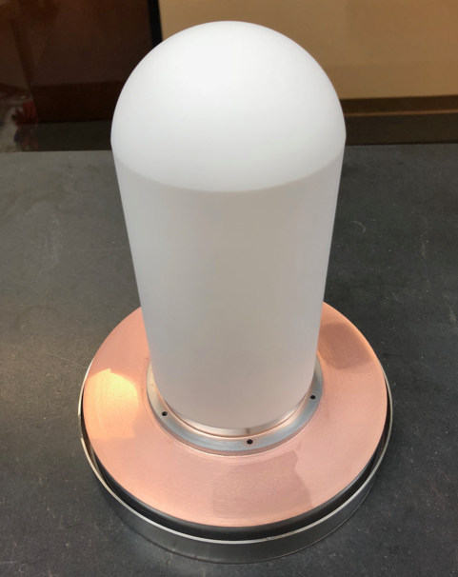
Magnetron cathodes and rf window
You may use kitchen microwave ovens to make popcorn. They are powered by magnetrons and the oven is an example of a (non-superconducting) RF cavity.
1497 MHz Cathode Stalks
1497 MHz RF Window

Slide 8
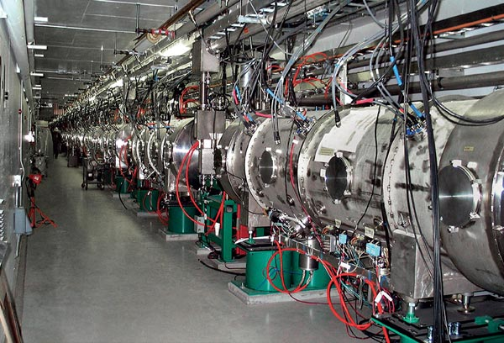
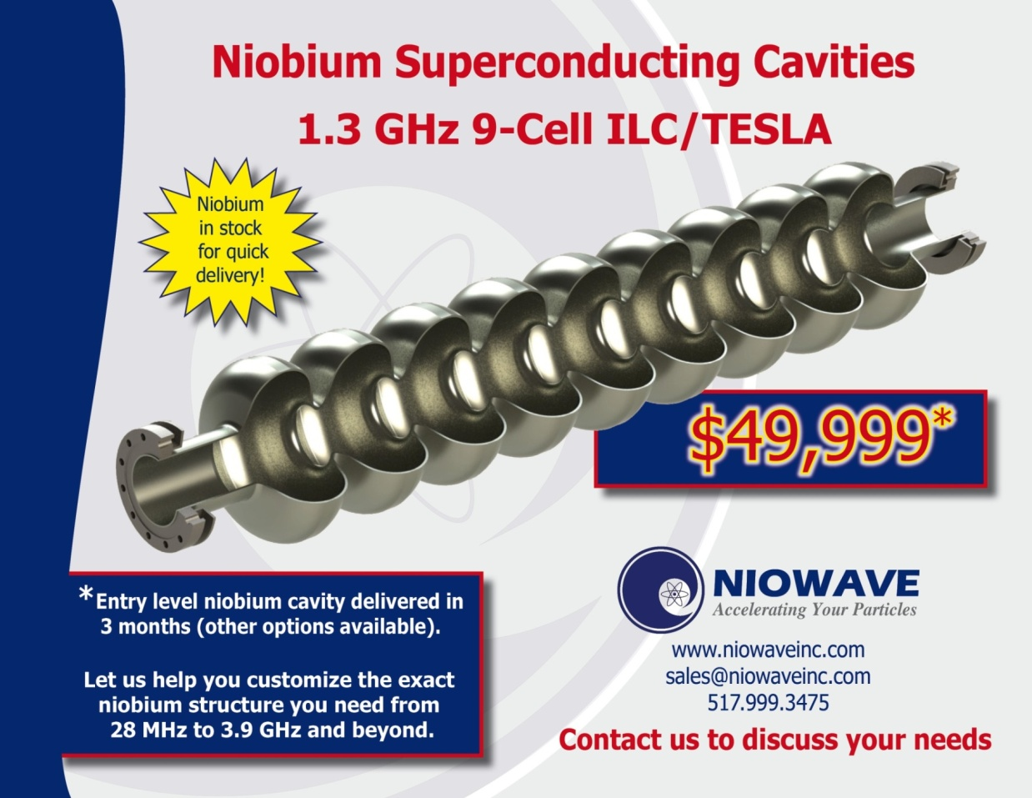
Superconducting RF Linacs
Driving Subcritical Reactors
Breakthrough Technology – Superconducting RF Linac
  Demonstrated at the ORNL Spallation* Neutron Source (SNS)
  Generates many neutrons to control reactor reactivity
  Powerful, efficient, affordable, reliable
  *1 p produces > 30 n

Slide 9
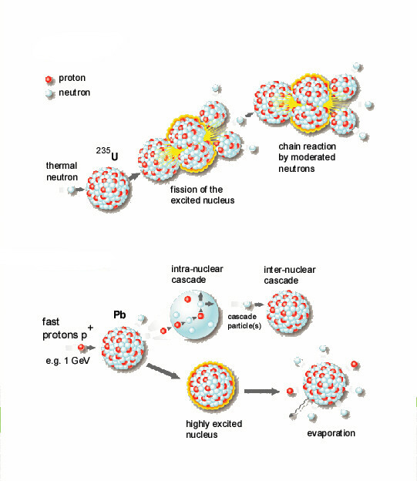
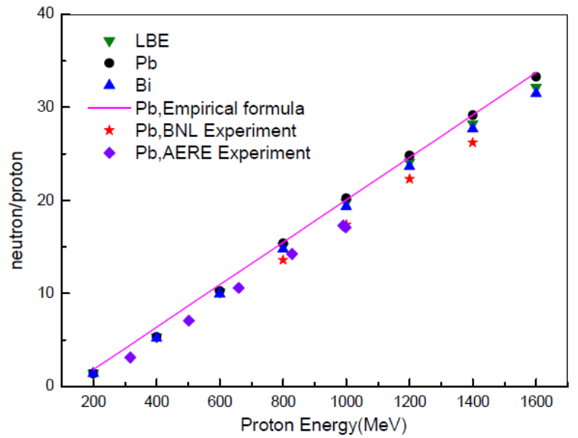
Spallation requires Protons

Slide 10
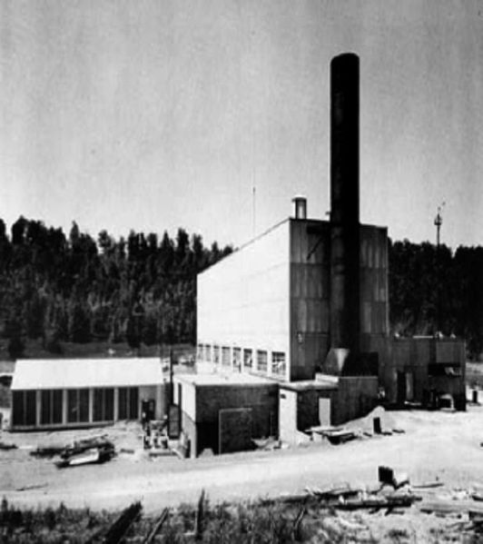
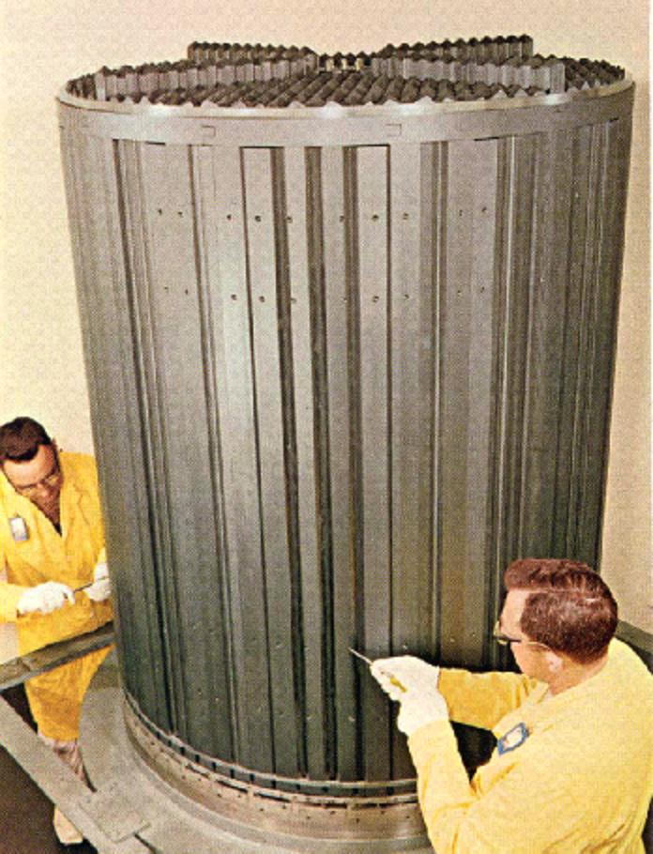
ORNL Molten Salt Reactor Experiment
Molten Salt Reactor Experiment operated at ORNL,1964-1969.
Demonstrated the key aspects of using molten salt fuel.
Critical reactor tested with three different fuels.
Mu*STAR based on MSRE parameters-Temperature, graphite, Hastelloy-N
Graphite MSRE core ¼ linear dimension of Mu*STAR, 4³ = 64 times Power

Slide 11
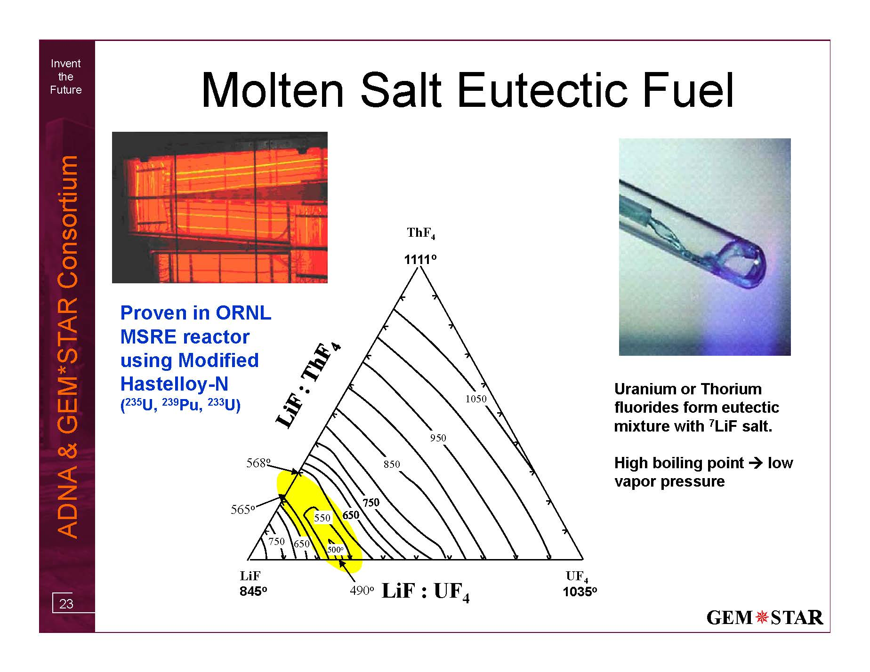
Molten Salt Eutectic Fuel

Slide 12
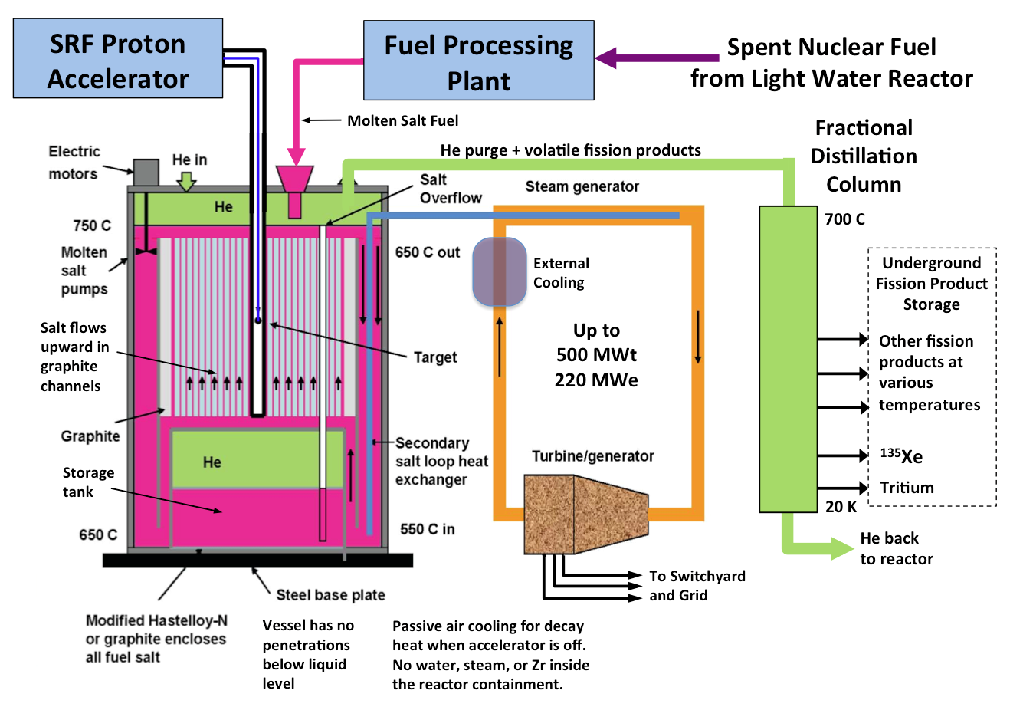
Reactor Concept
C. D. Bowman, R.B. Vogelaar,
et al., 2010 HB of NE
No penetrations below level of fuel

Slide 13
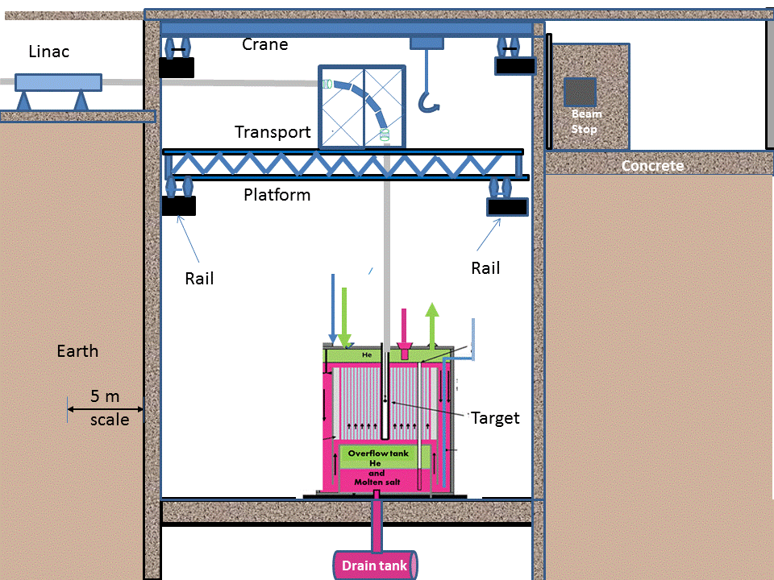
Underground Linac and Reactors

Slide 14
SRF Linacs Driving Subcritical MS Reactors
Why This Approach is Superior
Deepest Burn – Unique to SC Linac & Mu*S
Driven by Superconducting RF Linacs
  Newest technology for highest proton power (>25 MW)
Molten Fluoride Salt Fuel Reactor (MSRE experience)
  Accommodates short beam interruptions
Internal Spallation target
  Amplifies neutron flux by factor of >30
Graphite moderated thermal neutron spectrum
  Less sensitivity to fission products
  New Features
Subcritical - defense in depth by controlling fuel reactivity
  Fission turned off by switching the accelerator off
Continuous removal of volatile radioisotopes
Versatile reactor design accommodates many fuels
2 Examples of Deep Burn (compare to LWRs)
Burning SNF on LWR sites for energy security, clean-up
Burning Pu for tritium needed for weapon security, clean-up

Slide 15
Deep Burn Example #1
New Economics for SNF
  Convert LWR SNF into molten fluoride salt fuel for Mu*STAR
    Muons New DOE GAIN Award (with ORNL, SRNL, INL)
      Gateway for Accelerated Innovation in Nuclear (GAIN)
      https://info.ornl.gov/sites/publications/Files/Pub117081.pdf
  Burn the M-S fuel for 200 years
    Without chemical reprocessing
    Only increasing the accelerator power
    Until it takes 15% of the reactor power to run the accelerator
  Extract 7 times the energy as was generated by the original LWR
    Energy normalized waste reduced by more than a factor of 7
    Toxicity reduced – higher actinides burned
  SNF becomes a valuable commodity

Slide 16
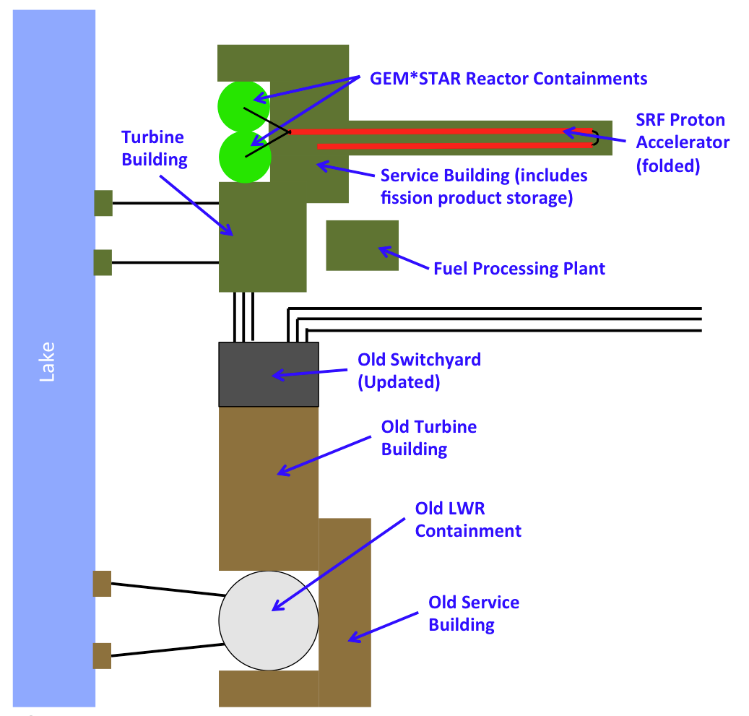
Mu*STAR SNF Concept
Build Mu*STAR at 65 existing LWR sites
Convert SNF to fluoride MS fuel once
  GAIN award with ORNL, SRNL, INL
Burn to get 7 times as much energy
  For 200 years
Disruptive Technology
  No uranium mining
  No fuel enrichment
  No fuel rod manufacture
  No new SNF
  No SNF transport
  No SNF remote storage
Consent based storage of SNF
  Community support
  Same amount of SNF as now
  Lots of jobs, economic stability
Goal – electricity for less than from gas
Reactor pits

Slide 17
Deep Burn Example 2
Making Tritium for the NNSA
  The Vision –
  -Mu*STARs at 65 US and many foreign LWR sites
  burning their existing stored SNF
  for >200 years
  How to get there?
    Need to build a Mu*STAR demo system
  Get the NNSA to pay for it to make tritium by burning Pu
    Solve their problems
    -need 2.8 kg/y tritium starting in 2025
    Save the US taxpayer money
    -now $300,000,000 kg

Slide 18
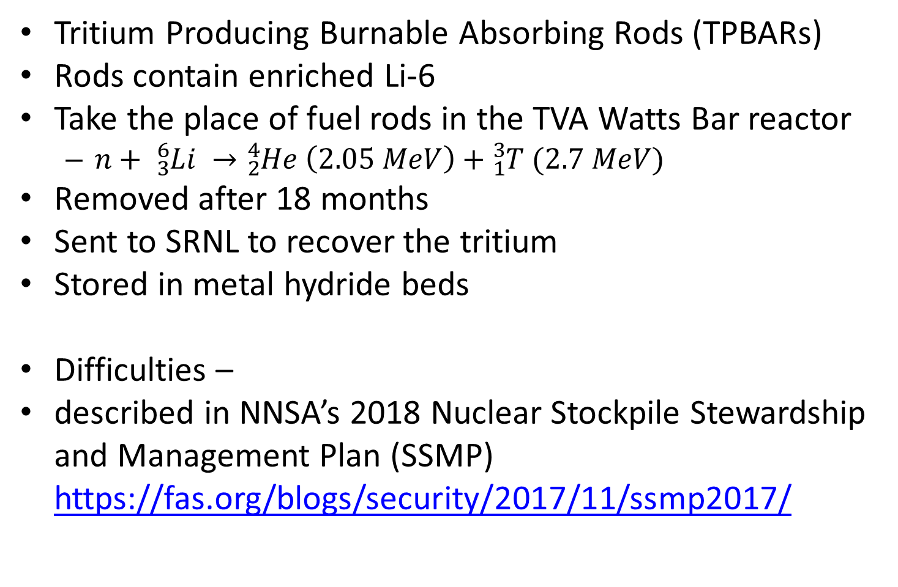
NNSA Makes Tritium Now
Tritium Producing Burnable Absorbing Rods (TPBARs)
Rods contain enriched Li-6
Take the place of fuel rods in the TVA Watts Bar reactor
  $n+ {}_{3}^{6}{Li} →{}_{2}^{4}{He} \left(2.05 MeV\right)+{}_{1}^{3}T (2.7 MeV)$
Removed after 18 months
Sent to SRNL to recover the tritium
Stored in metal hydride beds
Difficulties –
described in NNSA’s 2018 Nuclear Stockpile Stewardship and Management Plan (SSMP) https://fas.org/blogs/security/2017/11/ssmp2017/

Slide 19
Difficulties, Uncertainties, Expenses
National security function on commercial site
  Subject to local, state, EPA, NRC regulation
  Number of TPBARs limited – e.g. tritium in cooling water
  NNSA pays TVA to use Watts-Bar ($?)
Reactor fuel must be of national origin
  Need US owned, US sited uranium enrichment facility (>$2B)
ORNL (Y-12) Li-6 enrichment facility obsolete ($?)
2.8 kg/y of tritium needed after 2025
  Weapon decommissioning ends
  Additional reactor(s) needed
    to be upgraded and certified for TPBARs ($?)
Mu*STAR solves all these problems and saves money
  Scaled back accelerator and only one μ*S module can make >2.4 kg/y of T
  Essentially a μ*S pilot plant (~$1B)

Slide 20
Technology Readiness Levels
1 | Basic principles observed and reported.
2 | Technology concept and/or application formulated.
3 | Analytical and experimental critical function and/or characteristic proof of concept.
4 | Component and/or breadboard validation in a laboratory environment.
5 | Component and/or breadboard validation in a relevant environment.
6 | System/subsystem model or prototype demonstration in a relevant environment.
7 | System prototype demonstration in an operational environment.
8 | Actual system completed and qualified through test and demonstration.
9 | Actual system proven through successful mission operations.
Mu*STAR Components Technology Readiness
Component | Readiness Level | Comment / Example
Accelerator – 1 MW | 9 | SNS at ORNL
Accelerator – 10 MW | 7 | SNS is a “prototype”: 1 MW with 6% duty factor
Molten-Salt Reactor | 6 | Molten Salt Reactor Experiment at ORNL
Spallation Target | 6 | Other designs (in many places) are level 9
LWR SNF to MSF | 6 | 2017-18 Muons GAIN Voucher Subject. Known techniques, but cost optimization required.

Slide 21
Estimates of Costs
$ 15M System Study 1.5 y Using National Labs
$ 35M Conceptual Design 1.5 Y and following DOE
$150M Technical Design 2.0 y Critical Decision
$800M Pilot Plant large enough to make >2 kg/y of T 2.0 y Methodology
NRC confirmed that subcritical operation means Mu*STAR is not a nuclear reactor and should be exempt from many regulatory expenses and uncertainties.
NRC approval not required for Pilot Plant on DOE/NNSA site.

Slide 22
Outro (questions)
How can Mu*STAR be cheaper than wind, solar, or ng with free or cheap fuel?
  Because our fuel (e. g. SNF or Pu) is cheaper than free
    We will be paid to dispose of it
  May be more environmentally cost effective and attractive than Wind, Solar, or NG
    Considering birds, toxic waste, and greenhouse gases
Isn't nuclear too expensive?
  Subcritical means Mu*STAR does not fall under NRC rules for nuclear reactors
    It will have a smaller regulatory burden
    As an SMR it will be built in factories
    Reducing source term means smaller evacuation zone footprint
Aren't superconducting accelerators too expensive and spallation targets difficult?
  Research requirements are more demanding than needed for Mu*STAR
  SC RF technology is on the front end of a steep learning curve
    magnetrons, Nb3Sn, cryocoolers,…

